Slide 1
Investigating Relationships between Age of First Drug Use & Current Drug Use
David Stanko

Slide 2
Introduction
What is the relationship between age of first drug use and current drug use?
Data
Survey data from the National Survey on Drug Use and Health
About 3,000 questions and 33,000 responses
One variable per question + imputed variables
Numerical, categorical, and binary variables for the same question
Models
Decision tree: marijuana use
Bagging: alcohol use
Boosting: tobacco use
Random forest: cigarette use

Slide 3
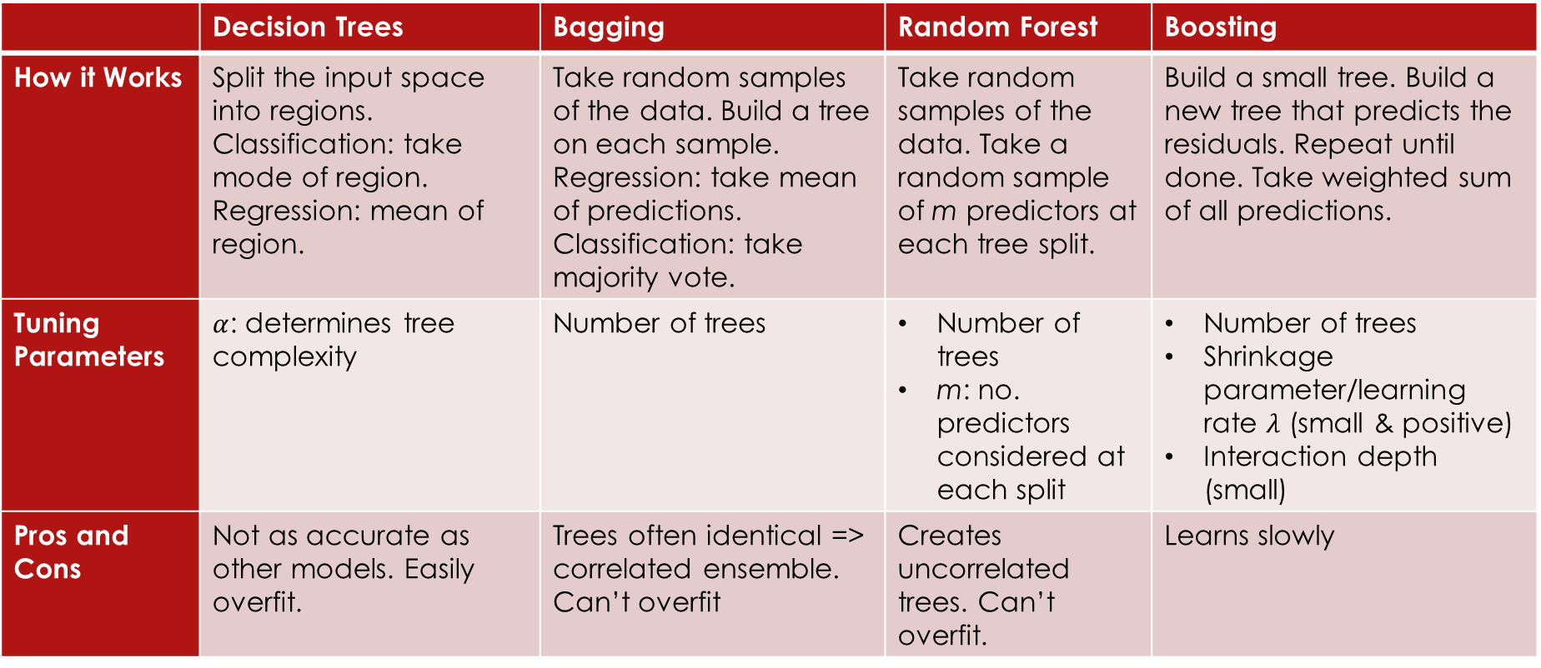
Theoretical Background
 | Decision Trees | Bagging | Random Forest | Boosting
How it Works | Split the input space into regions. Classification: take mode of region. Regression: mean of region. | Take random samples of the data. Build a tree on each sample. Regression: take mean of predictions. Classification: take majority vote. | Take random samples of the data. Take a random sample of m predictors at each tree split. | Build a small tree. Build a new tree that predicts the residuals. Repeat until done. Take weighted sum of all predictions.
Tuning Parameters | $α$: determines tree complexity | Number of trees | Number of trees m: no. predictors considered at each split | Number of trees Shrinkage parameter/learning rate $λ$ (small & positive) Interaction depth (small)
Pros and Cons | Not as accurate as other models. Easily overfit. | Trees often identical => correlated ensemble. Can’t overfit | Creates uncorrelated trees. Can’t overfit. | Learns slowly

Slide 4
Methodology

Slide 5
Data Processing
Variables kept
num_alc_days_past_year
num_marij_days_past_year
num_cig_days_past_month
num_tobacco_days_past_month
num_alc_days_past_month
num_marij_days_past_month
cig_age_class
tobacco_age_class
first_alc_use_age
first_marij_use_age
Removed decimal values for drug use frequencies
Replaced special codes (91, 93, …) with 0
Converted some numerical age variables into bins
Made a feature set for each model (75% training, 25% test)

Slide 6
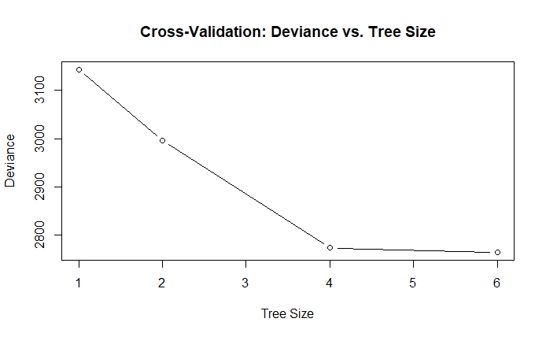
Decision Tree: Age of First Marijuana Use
Numerical response variable
10-fold cross validation for tree complexity using cv.tree()
Test metric: RMSE

Slide 7
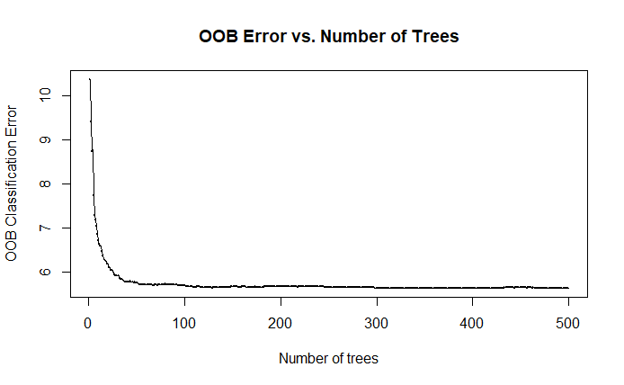
Bagging: Age of First Alcohol Use
Best: 100 trees
Numerical response variable
Test metric: RMSE

Slide 8
Boosting: Age of First Tobacco Use
Classes
First tobacco use under 12
First tobacco use at 12+, or never used tobacco
Test metrics
Accuracy for each class
Accuracy across all classes
Tuning Parameter | Values Tried | Best Value
Interaction depth | 1, 2, 3, 4 | 1
Number of trees | 10, 50, 100, 500, 1000 | 10
Shrinkage parameter | 0.001, 0.01, 0.1 | 0.001
Min. no. observations in terminal nodes | 10 | 10

Slide 9
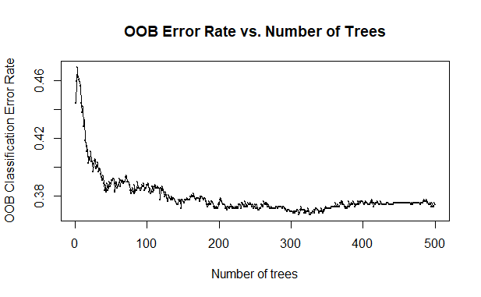
Random Forest: Age of First Cigarette Use
Classes
Under 12
12-13
14-17
Never used cigarettes
Tuning m (number of predictors at each split)
Tried m = 1, 2, and 4
Best: m = 1
Test metrics
Accuracy for each class
Accuracy across all classes
Best: 250 trees

Slide 10
Results + Discussion

Slide 11
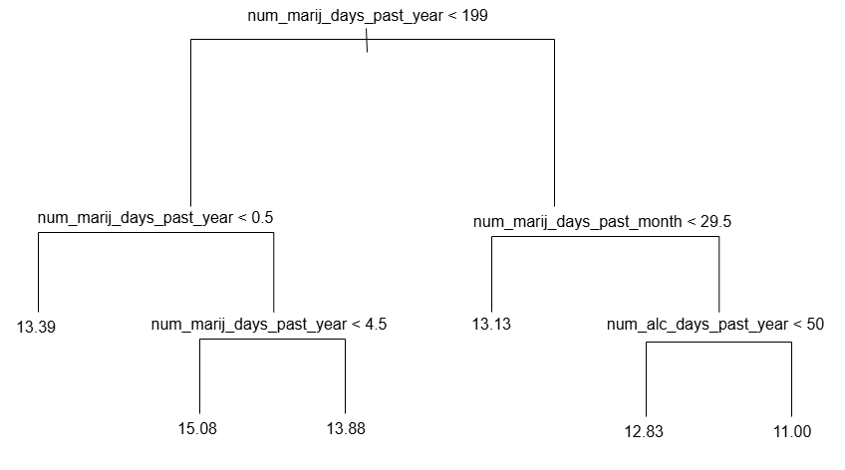
Decision Tree
Test RMSE: 1.81 years of age

Slide 12
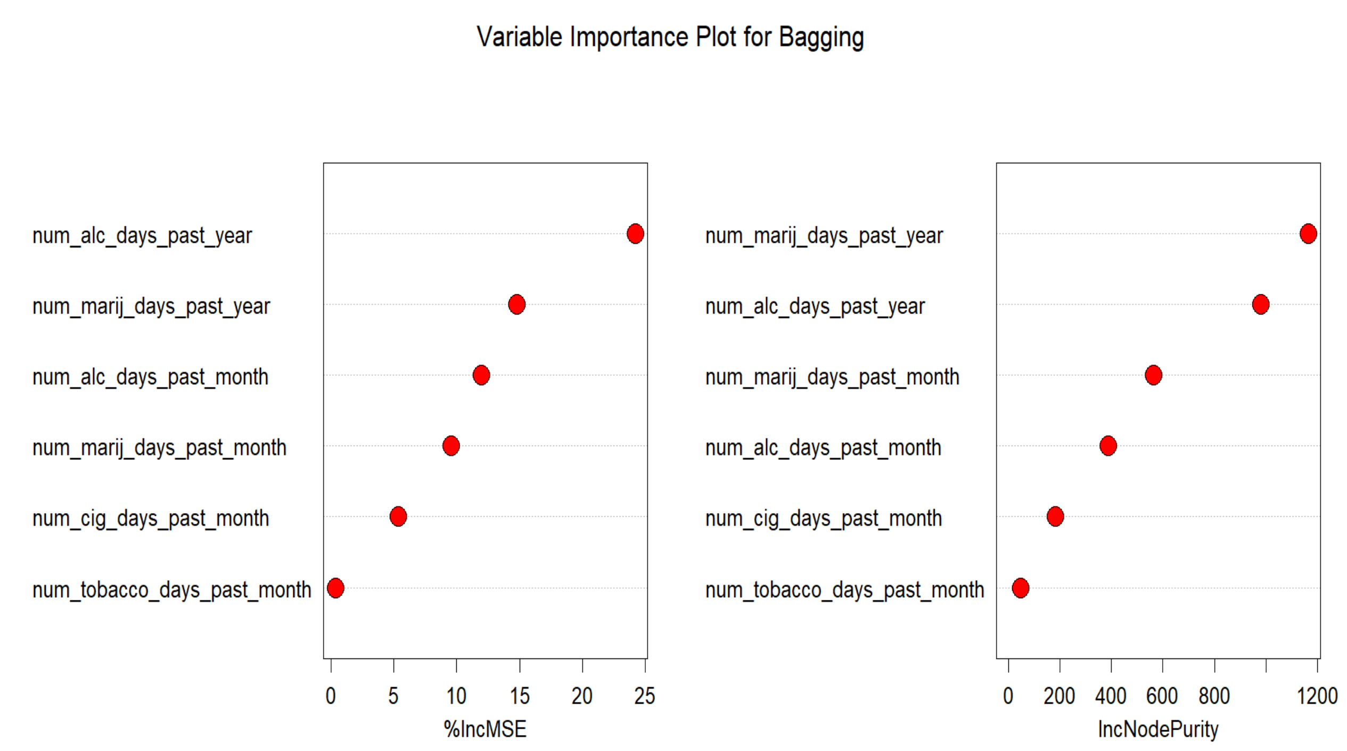
Bagging
Test RMSE: 2.49 years of age

Slide 13
Boosting: Metrics
Class Distribution in Training Set
Confusion Matrix for Test Set
Actual
Class Name | 12+ or never used | Under 12
Number of Samples | 877 | 8
 | 12+ or never used | Under 12
12+ or never used | 291 | 3
Predicted
Class Distribution in Test Set
Test Metrics
Class Name | 12+ or never used | Under 12
Number of Samples | 291 | 3
Test accuracy for 12+ or never used | Test accuracy for under 12 | Overall test accuracy
100% | N/A | 99%

Slide 14
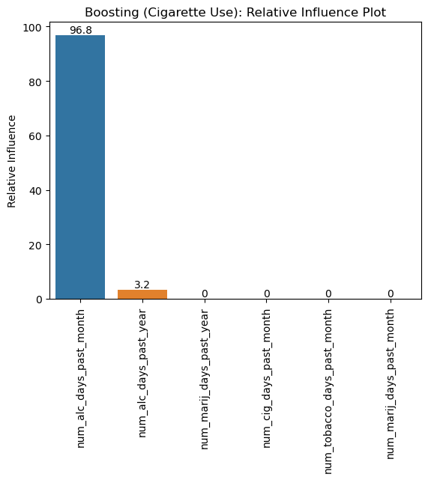
Boosting: Relative Influence Plot

Slide 15


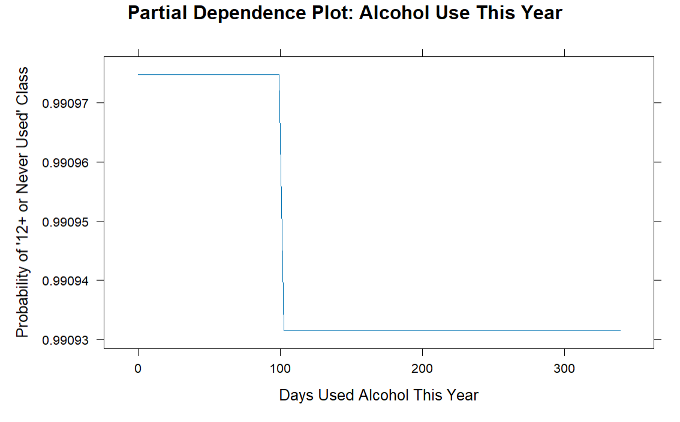
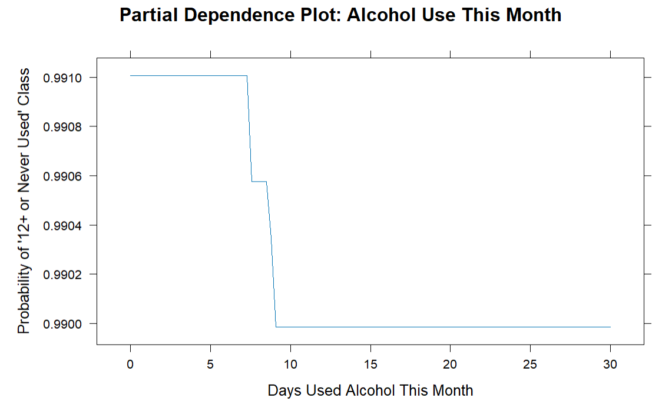



Boosting: Partial Dependence Plots

Slide 16
Random Forest: Metrics
Class | Number of Samples in Training Set | Number of Samples in Test Set | Test Accuracy for that Class
Under 12 | 87 | 25 | 0%
12-13 | 105 | 35 | 0%
14-17 | 171 | 62 | 27.4%
Never used | 522 | 172 | 100%
Overall Accuracy | 64.2%

Slide 17
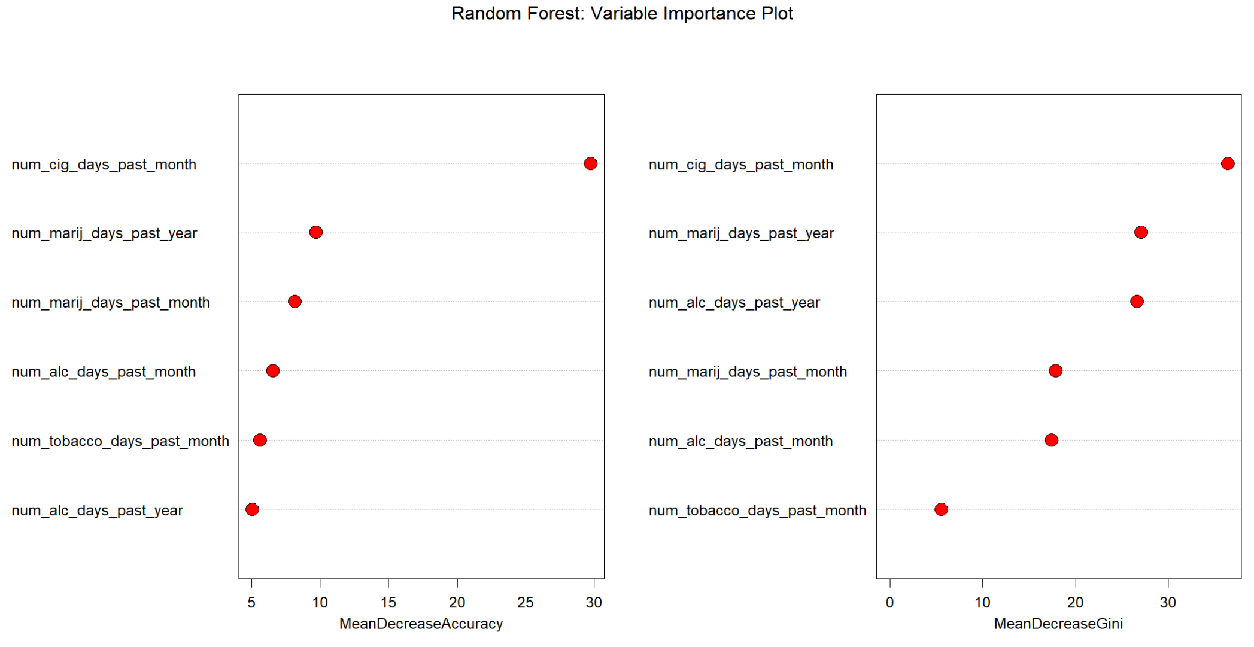
Random Forest: Variable Importance Plot

Slide 18
Limitations, Improvements, and Extensions
Limitations
Class imbalance problem!
No yearly frequency variables for tobacco or cigarettes
Improvements/extensions
Oversampling or undersampling algorithms
Much potential for future research questions
Relationship between family/peer experiences & age of first drug use
Effect of age of first drug use on mental health

Slide 19
Discussion Question 1: Some of these variables are the same information coded into binary, ordinal (categorical and ordered), and numerical variables. How do the predictions change using each data type? What is each telling you, and when is it appropriate to use each?

Slide 20
Discussion Question 1
Numerical variables are exact and precise
Ordinal or binary variables are broader and less specific
Use binary or ordinal variables when classes are balanced
Use numerical variables when predicting a precise quantity
Predictions for ordinal variables
Perform classification, not regression
Be careful about what the categories represent
Predictions for binary variables
0/1 is easier to interpret
Predictions for numerical variables
Easiest to interpret

Slide 21
Discussion Question 2: Which variables tend to be important for predicting drug use? How can these be interpreted? What are the implications of this outcome? How can you, as the data science communicator, discuss these findings in an ethical way?

Slide 22
Discussion Question 2
Important variables
Marijuana frequency (3 times)
Alcohol frequency (3 times)
Cigarette frequency only important for age of cigarette use
Tobacco frequency not important
Youth who started using drugs younger, currently use more alcohol and marijuana now
Implications
Younger youth might be more at risk of addiction
Ethics
Discuss only findings that are supported by the models
Don’t jump to conclusions about addiction: harmful consequences
Don’t release the trained model

Slide 23
Conclusions
Youth who started using drugs younger, use more alcohol and marijuana now
Positive & negative impacts of these findings
Real world use
Extend this research to see how mental health, peer/family relationships, etc., influence long-term drug use patterns

Slide 24
Sources
1. Gulati, J. (2025, February 5). How to Implement Gradient Boosting Machines in R. Statology. https://www.statology.org/how-to-implement-gradient-boosting-machines-r/
2. Kearns, M., & Roth, A. (2020). The ethical algorithm: the science of socially aware algorithm design. Oxford University Press.

